Slide 1
TESTING PRINCIPLES AND PRACTISE
COMP220/285
© University of Liverpool
slide <number>

Slide 2
Testing Principles
Testing shows presence of errors
  Not their absence
Exhaustive testing is not possible/practical
  In most cases
Test early and regularly
  Early testing reduces multiple bug/defect relation and avoids bug masking
Error clustering
  Errors are not evenly distributed
  Typically 20% of modules contain 80% of defects
COMP220/185
© University of Liverpool
slide <number>

Slide 3
Testing Principles
Pesticide paradox
  Unless tests change they often become invalid, as functionality changes so must tests
  If we continue to use old tests, only bugs associated with old specification are removed
  Example browser compatibility testing (iPhone, Android)
Context dependency
  Medical system → Safety testing
  Website → Performance/load testing
  Banking application → Security testing
False conclusion: no errors equals usable system
COMP220/185
© University of Liverpool
slide <number>

Slide 4
What is testing
Determining the software conforms to the user’s requirements
Can include
  Verification (against the spec.)
  Validation (using customer or internal)
  Performance
  Security
  Usability
  Regulatory testing
  Statistical testing
COMP220/185
© University of Liverpool
slide <number>

Slide 5
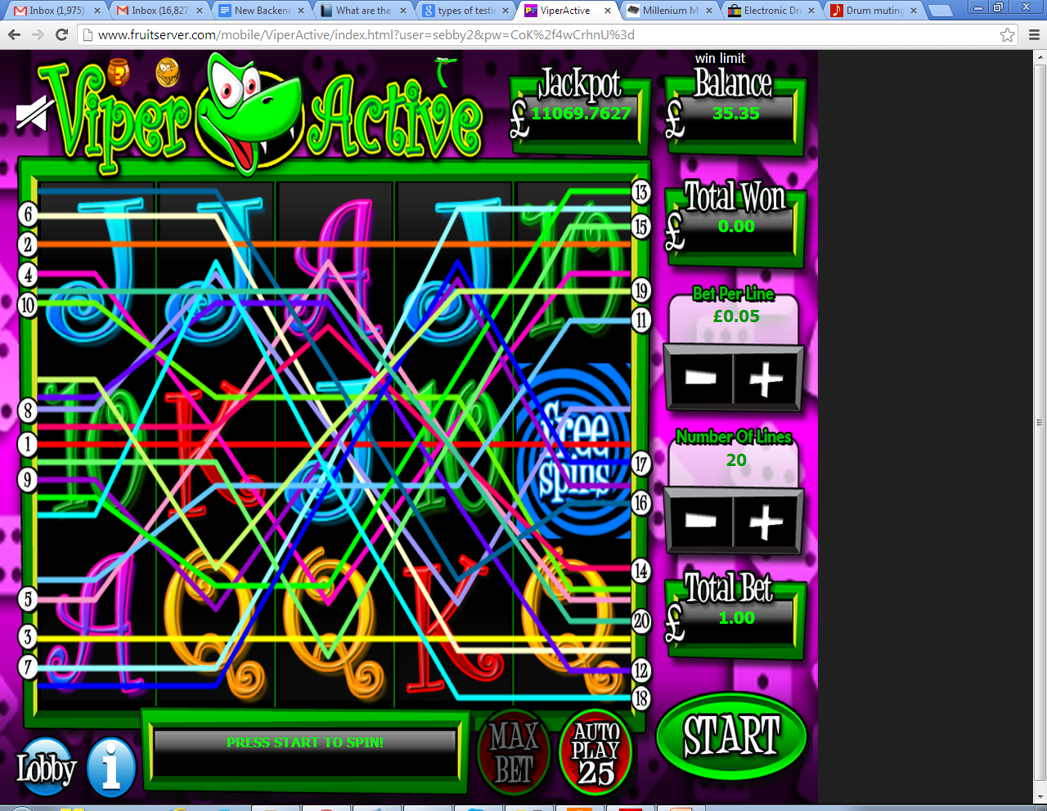
Case study.. game (how to test?)
UI testing
Performance testing
Functional testing
Regulatory testing
Statistical testing
COMP220/185
© University of Liverpool
slide <number>

Slide 6
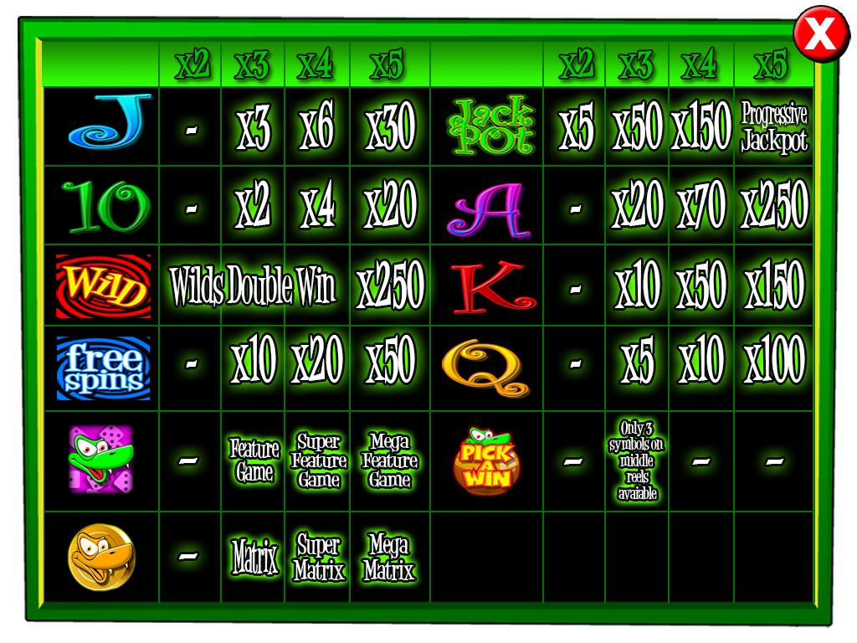

Win structure
COMP220/185
© University of Liverpool
slide <number>

Slide 7
Some Details
Each reel has 256 symbols
5 Reels
How many possible combinations?
  (256)^5 = 1,099,511,627,776
  10,000 spins/second = 636 days
Bigger problem
  How to write 1,099,511,627,776 test cases?
COMP220/185
© University of Liverpool
slide <number>

Slide 8
Statistical testing
Execute a subset of the tests for the game (500 million games) and determine
  Each win’s probability
  Total payout of game
  If payout is within expected range
    Plus or minus 2 standard deviations from mean
COMP220/285
© University of Liverpool
slide <number>

Slide 9
Win structures and payout rules
TEN TEN TEN // 3 inline wins
  WILDS substitute
  So TEN WILD TEN pays a 3 x TEN win
Four line wins
  TEN TEN TEN TEN
  TEN TEN WILD TEN
How about
  WILD WILD J TEN
COMP220/185
© University of Liverpool
slide <number>

Slide 10
Rules
Wilds substitute for other symbols
20 pay lines, following from left to right
2, 3, 4, 5 in line possible wins
Stake can be changed for each spin
COMP220/185
© University of Liverpool
slide <number>

Slide 11
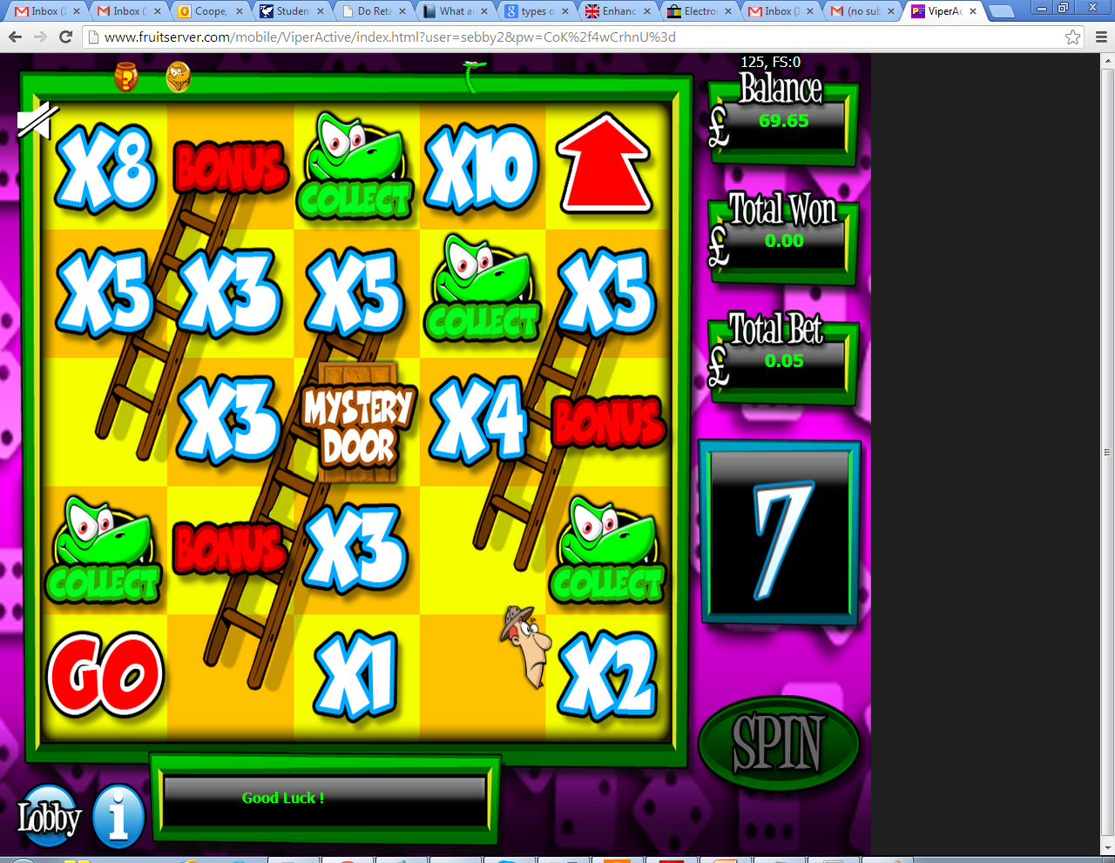
Special features
Some wins give a game within a game, this is called a feature…
COMP220/185
© University of Liverpool
slide <number>

Slide 12




Scattered symbols
Some symbols appear anywhere in the window, so below generates 4 symbol feature win.
How many
Combinations give 4 snakes?
COMP220/185
© University of Liverpool
slide <number>

Slide 13
Exercise
How many combinations give 4 snakes?
What combinations give 4 snakes?
Can we test them all?
Use software to generate test cases?
  Write a small Java program to generate these test cases
COMP220/185
© University of Liverpool
slide <number>

Slide 14
Feature wins
Generate a range of random prizes
Testing issues
  Distribution of prizes
  Average prize distribution
  Maximum prize
  Minimum prize
COMP220/185
© University of Liverpool
slide <number>

Slide 15
Target code
int getWinValue(int stake,int symbols[][])
stake is amount of money awarded per payline
stake is in pence/cents
Symbols
  5 x 3 array displaying symbols in window
  1= TEN, 2 = J, 3 = Q
COMP220/185
© University of Liverpool
slide <number>

Slide 16
Testing approach
At least orthogonal
So each range of data but not every combination of each range
Each win type including/excluding wilds
For a given win, choose a range of stakes
  Ensure the multiplier works
  Try on each different payline
COMP220/185
© University of Liverpool
slide <number>

Slide 17
Orthogonal testing and modes
Function
  countDaysTill(int day,int month,int year)
Bug might appear in test case for particular
  day, month, year (triple mode fault)
  Year (single mode fault)
  day, month (double mode fault)
Exhaustive testing of some single mode faults is sometimes possible
COMP220/185
© University of Liverpool
slide <number>

Slide 18
Orthogonal array testing
Imagine you have a method with 3 integer arguments
Arg1 range 1-10
Arg2 range 2-20
Arg3 range 5,6 or 7
You want to catch all single mode errors
  How many tests need?
  What tests?
COMP220/285
© University of Liverpool
slide <number>

Slide 19
Orthogonal array testing
Total test count (single mode)
  10 for arg1 + 19 for arg2 + 3 for arg3
  = 10+19+3 = 32 tests (actually only 30, some are redundant)
Single mode errors
  Number of tests is order of N (where N is argument levels)
Triple mode errors
  Number of tests is order of N^3
  In the case above 570 tests (10x19x3)
COMP220/285
© University of Liverpool
slide <number>

Slide 20
Orthogonal array testing
Tests for single mode
Test | Arg1 | Arg2 | Arg3
1 | 1 | 2 | 5
2 | 2 | 2 | 5
3 | 3 | 2 | 5
4 | 4 | 2 | 5
5 | 5 | 2 | 5
6 | 6 | 2 | 5
7 | 7 | 2 | 5
8 | 8 | 2 | 5
9 | 9 | 2 | 5
10 | 10 | 2 | 5
11 | 1 | 3 | 5
12 | 1 | 4 | 5
13 | 1 | 5 | 5
14 | 1 | 6 | 5
15 | 1 | 7 | 5
16 | 1 | 8 | 5
17 | 1 | 9 | 5
18 | 1 | 10 | 5
19 | 1 | 11 | 5
20 | 1 | 12 | 5
21 | 1 | 13 | 5
22 | 1 | 14 | 5
23 | 1 | 15 | 5
24 | 1 | 16 | 5
25 | 1 | 17 | 5
26 | 1 | 18 | 5
27 | 1 | 19 | 5
28 | 1 | 20 | 5
29 | 1 | 20 | 6
30 | 1 | 20 | 7
COMP220/285
© University of Liverpool
slide <number>
Notes:
<Program Title>

Slide 21
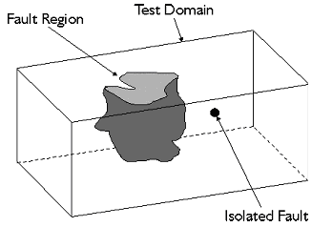
Defect density, clustered or isolated
COMP220/285
© University of Liverpool
slide <number>

Slide 22
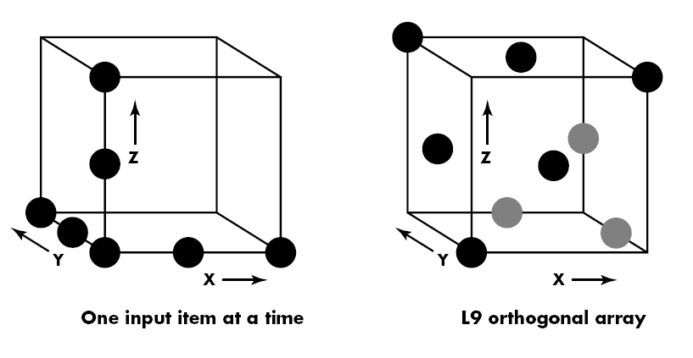
In practise
Most recommendations is for at least all pair-wise combinations (this is what most people will call orthogonal array test)
Use a tool to generate test array, then complete by hand
My generating the “other” values randomly for each test, you distribute your tests around the state space
COMP220/285
© University of Liverpool
slide <number>

Slide 23
Orthogonal testing for our game
So if stake can be
  10p,50p,100p,200p,500p
Single mode test for stake could use the following test cases
STAKE | REEL1 | REEL 2 | REEL 3 | REEL 4 | REEL 5 | Output
10 | TEN | TEN | TEN | JACK | JACK | 30
50 | TEN | TEN | TEN | JACK | JACK | 150
100 | TEN | TEN | TEN | JACK | JACK | 300
200 | TEN | TEN | TEN | JACK | JACK | 600
500 | TEN | TEN | TEN | JACK | JACK | 1500
COMP220/185
© University of Liverpool
slide <number>

Slide 24
Orthogonal testing
Now test 3 in line TEN wins (keep stake constant)
STAKE | REEL1 | REEL 2 | REEL 3 | REEL 4 | REEL 5 | Output
10 | TEN | TEN | TEN | JACK | JACK | 30
10 | WILD | TEN | TEN | JACK | JACK | 30
10 | TEN | WILD | TEN | JACK | JACK | 30
10 | TEN | TEN | WILD | JACK | JACK | 30
10 | WILD | WILD | TEN | JACK | JACK | 30
10 | WILD | TEN | WILD | JACK | JACK | 30
10 | TEN | WILD | WILD | JACK | JACK | 30
COMP220/185
© University of Liverpool
slide <number>

Slide 25
More testing of the machine
Do we/Can we testing all losing lines?
  Alternatives?
    Statistics
Random test generation
  Rand = random (but no Wild, no Ten)
STAKE | REEL1 | REEL 2 | REEL 3 | REEL 4 | REEL 5 | Output
10 | TEN | TEN | TEN | Rand | Rand | 30
10 | WILD | TEN | TEN | Rand | Rand | 30
10 | TEN | WILD | TEN | Rand | Rand | 30
10 | TEN | TEN | WILD | Rand | Rand | 30
10 | WILD | WILD | TEN | Rand | Rand | 30
10 | WILD | TEN | WILD | Rand | Rand | 30
10 | TEN | WILD | WILD | Rand | Rand | 30
COMP220/185
© University of Liverpool
slide <number>

Slide 26
Adding in random numbers
Teases out rarer bugs
Can do different tests across Q&A phases
Increases assurance
Can be used to make statistical inference
COMP220/185
© University of Liverpool
slide <number>

Slide 27
Testing calculations
  If bug effects 0.01% of positions, evenly distributed and we test 10,000 positions randomly, what is the chance of a false positive
    Chance of test giving false positive
    Chance of passing bug for each test is
      1 – (0.0001) = 0.9999
      Chance of not finding bug is
        (0.9999)^10,000 = 0.36 or 36%
COMP220/185
© University of Liverpool
slide <number>

Slide 28
Testing calculations
Assuming confidence of 1% (i.e. assuming we might be wrong 1% of time)
If we do 1,000,000 random tests what is maximum error density
(1-chance_of_bug)^10,000,000<0.01
So
10,000,000log(1-chance_of_bug)<log(0.01)
Log(1-chance_bug)<log(0.01)/10,000,000
1-chance_bug<10^(log(0.01)/10,000,000)
chance_bug=1-10^(log(0.01)/10,000,000)
0.0000046 defect density
COMP220/185
© University of Liverpool
slide <number>

Slide 29
Testing levels
At unit level
  Confirming the following all function correctly
    All methods provide primary function
    All constructors and methods validate input
    Exceptions are caught or thrown as required
  Coding by contract
    Each method has a required range of appropriate values
    Use of methods should conform with contract
COMP220/185
© University of Liverpool
slide <number>

Slide 30
Test Example
class Person.java
Constructor takes name and Date of birth
Has methods
  int getAgeInYears() // whole number of years old
  boolean isAdult() // true if Person is adult
Is meant to provide validation checking of its attributes
COMP220/185
© University of Liverpool
slide <number>

Slide 31
Testing example code (boundary cases)
private void testYears() {
Calendar dobCal = Calendar.getInstance(); // set up current time
dobCal.setTimeInMillis(System.currentTimeMillis()); // set up time
int testAge=18;
dobCal.add(Calendar.YEAR,-testAge);
setDateOfBirth(dobCal.getTime());
if (getAgeInYears()!=testAge) {
throw new TestFailException("Failed Age test Birthday today");
}
COMP220/185
© University of Liverpool
slide <number>

Slide 32
Fundamental problem with test code
Code is being written to test code
So if a bug happens
Is the bug in
  The target code
  The test code
Answers
  Have 2 teams (test code team, testing team)
  Use simple identities sqr(x) x sqr(x) = x
COMP220/185
© University of Liverpool
slide <number>

Slide 33
Testing Example
dobCal.add(Calendar.DAY_OF_MONTH, 1); // move to tommorow
setDateOfBirth(dobCal.getTime());
if (getAgeInYears()!=testAge-1) {
throw new TestFailException("Failed Age test Birthday tommorow");
}
COMP220/185
© University of Liverpool
slide <number>

Slide 34
Test Example
dobCal.add(Calendar.DAY_OF_MONTH, -2); // move to yesterday
setDateOfBirth(dobCal.getTime());
if (getAgeInYears()!=testAge) {
throw new TestFailException("Failed Age test Birthday yesterday");
COMP220/185
© University of Liverpool
slide <number>

Slide 35
Testing and debugging
Bug report
  Date, product name, platform (Windows, Linux, Chrome IE?)
  Description
  Logs (? Java console dump?), server trace log
  Version of software (see svn version)
  How to re-create the bug
COMP220/185
© University of Liverpool
slide <number>

Slide 36
Server logs (web debugging)
[10:07:23 AM] Cometa.Core.Server.CommandsNew.CommandGameInit.Execute. Begin...
,Arcadia 0.013215312 0.000165
[10:07:23 AM] Cometa.Core.Server.CommandsNew.CommandBase.AuthenticatePlayer. Begin...
,Arcadia 0.013653376 0.000438
[10:07:23 AM] Cometa.Core.Server.CommandsNew.AuthenticatePlayer. Loading user with login of sebby2
,Arcadia 0.01406112 0.000408
[10:07:23 AM] ExecuteDataset: Select * from $(user) Where LCASE(Login)='sebby2'
,Arcadia 0.014521312 0.000460
[10:07:23 AM] Cometa.Core.Server.CommandsNew.AuthenticatePlayer. User loaded okay, is valid, is in user role, is not blocked.
,Arcadia 0.019047712 0.004526
[10:07:23 AM] Cometa.Core.Server.CommandsNew.AuthenticatePlayer. Password matched.
,Arcadia 0.019882992 0.000835
[10:07:23 AM] ResponseMessageManager::GetMessageByShortCode: Begin...
,Arcadia
COMP220/185
© University of Liverpool
slide <number>

Slide 37
Validation testing (error case checking)
Calendar dobCal = Calendar.getInstance(); // set up current time
dobCal.setTimeInMillis(System.currentTimeMillis()); // set up time
dobCal.add(Calendar.DAY,1); // move to tomorrow
Person person=new Person();
Boolean testFailed=true;
try {
person.setDateOfBirth(badDate);
} catch (Exception) {
testFailed=false;
}
This could equally be done and should be done with constructor
Person p=new Person(“test”,”test”,”test”,”test”,”test”,badDate);
COMP220/185
© University of Liverpool
slide <number>

Slide 38
Need for automation
Many tests
Requirement for continuous regression testing
Rapid implementation of new functions
Less human error
Cost
  High up front cost in time/money
COMP220/185
© University of Liverpool
slide <number>

Slide 39
Summary
Hard to test all cases
Automation is essential to make testing effective
Orthogonal approach can be worth while to get coverage of modal bugs
COMP220/185
© University of Liverpool
slide <number>

